Slide 1
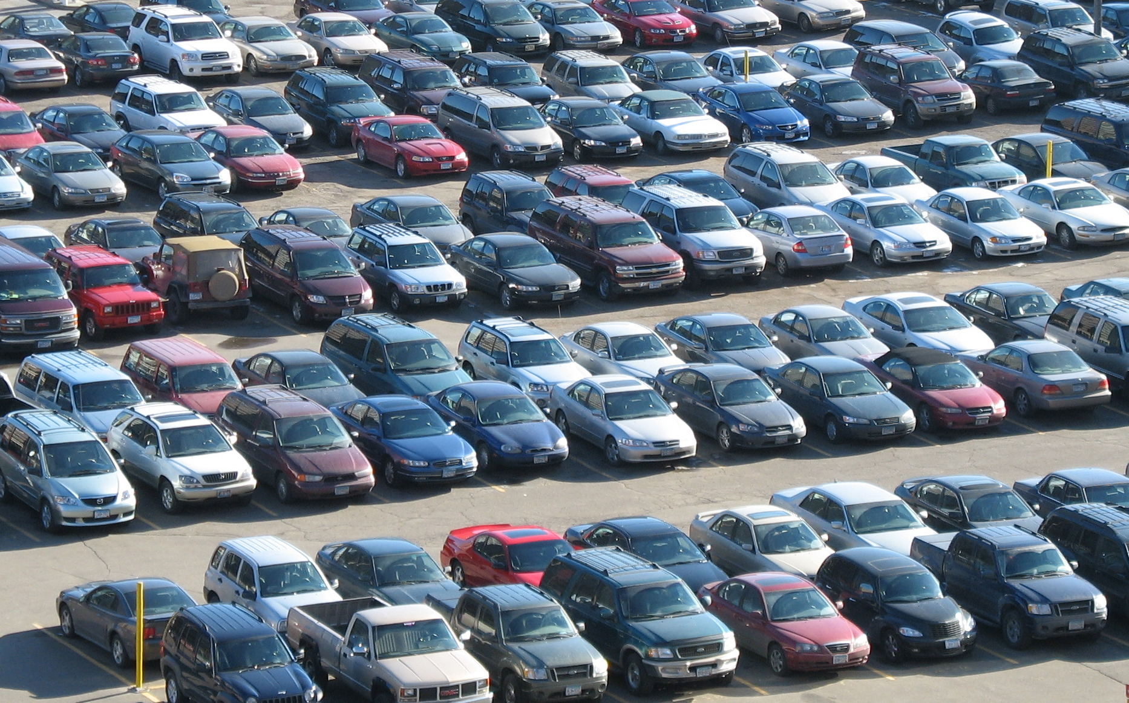
Parkar
Multi-goal pathfinding using cost-maps in real-time
Chinh Luu
Daniel Molski
Alexander Brewer
Mentor: Levent Albayrak
Digital Gaming and Simulation Department
Houston Community College
http://3.bp.blogspot.com/-dLwisoSyRA0/T7akLA7QwZI/AAAAAAAAACo/6OHqg6qK-J4/s1600/garagens.jpg
Notes:
Who are we: programming students from HCC digital gaming and simulation program

Slide 2
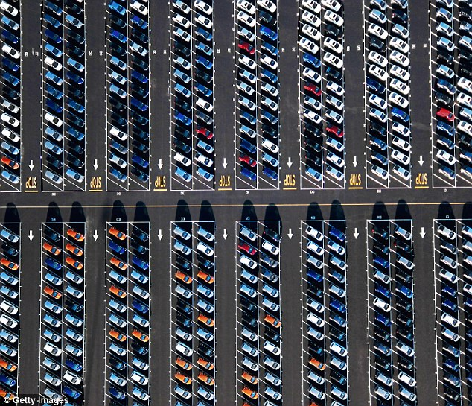
- Problem -
Busy lots take lots of time
Shopping malls
Hospitals
Airports
Grocery stores
Knowing where to find a spot would speed things up
https://i.dailymail.co.uk/i/pix/2016/08/25/20/379542C700000578-3758899-image-a-17_1472153675791.jpg

Slide 3
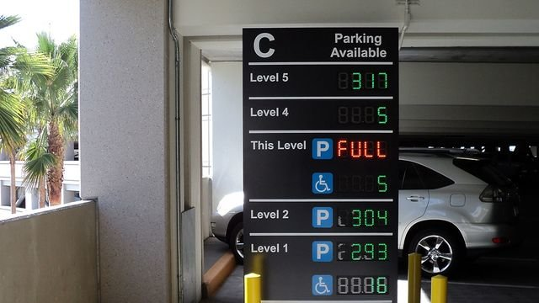
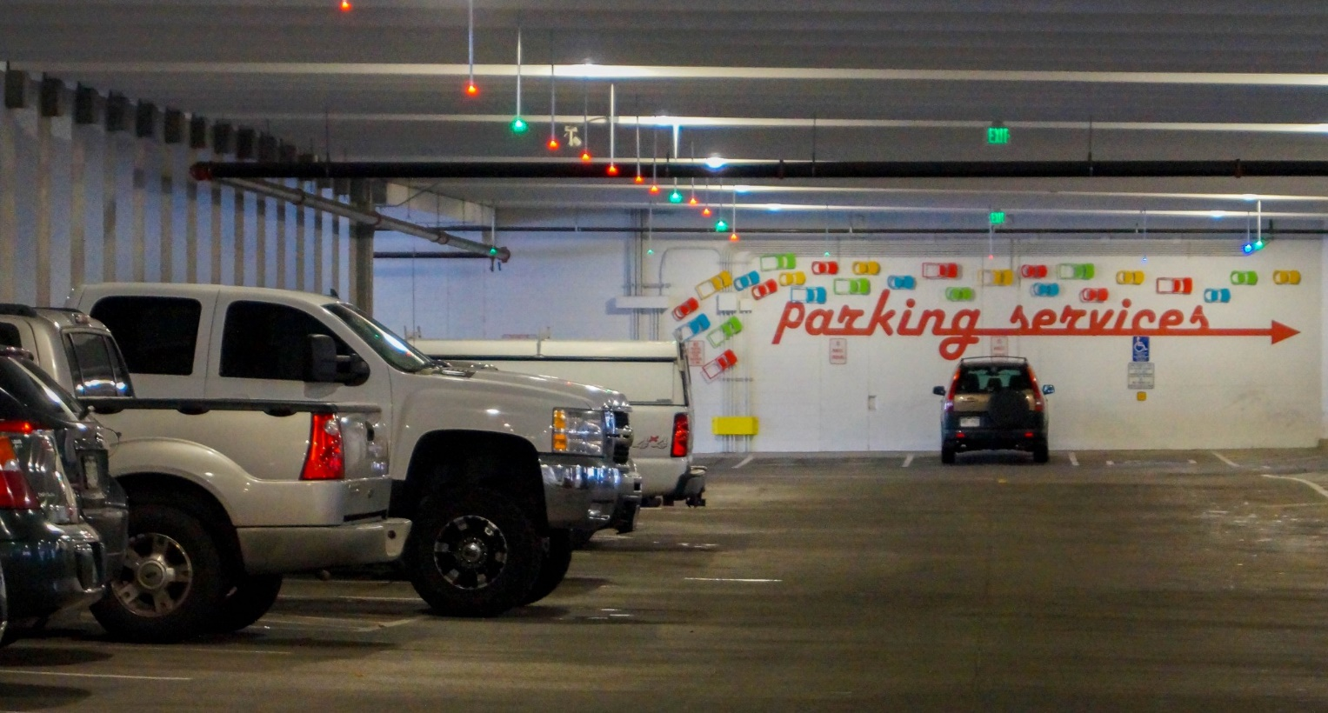

- Current Solutions –
Colored spot indicators
Spots left signs
Human guide
Known to be helpful

Slide 4
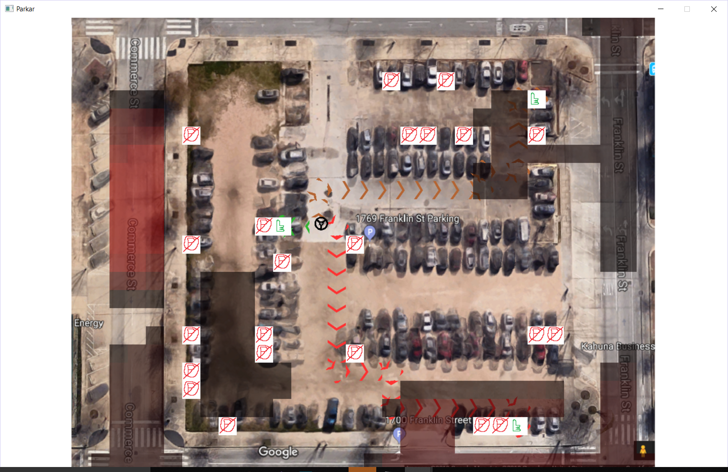
- Proposed idea –
App that points out open spots
Allow parking providers to create custom maps of their lots and provide parking spot availability/traffic information updates in real-time
App’s algorithm performs efficient multi-goal pathfinding and visualize paths to available parking spots using real-time data.

Slide 5
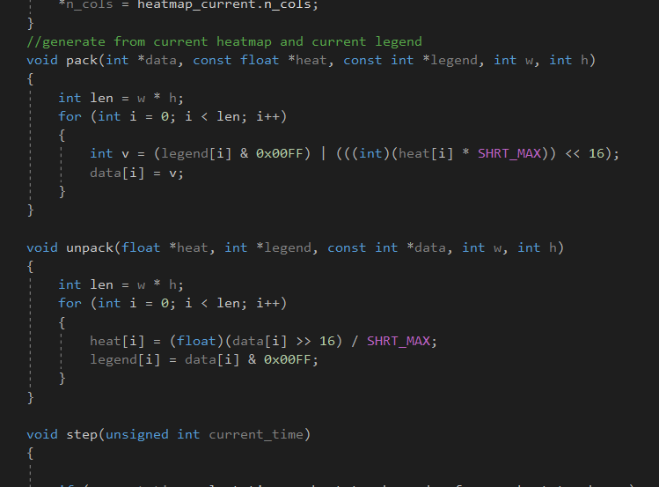
- Methods –
The entire solution was written at this Hackathon using C++ and SDL2 graphics library
~900 lines of code

Slide 6
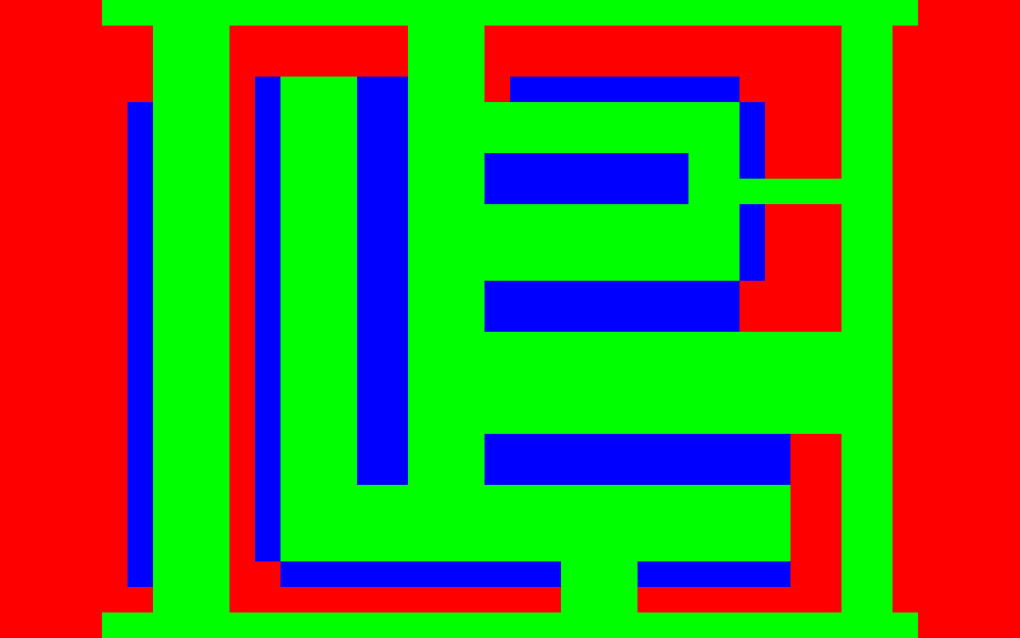
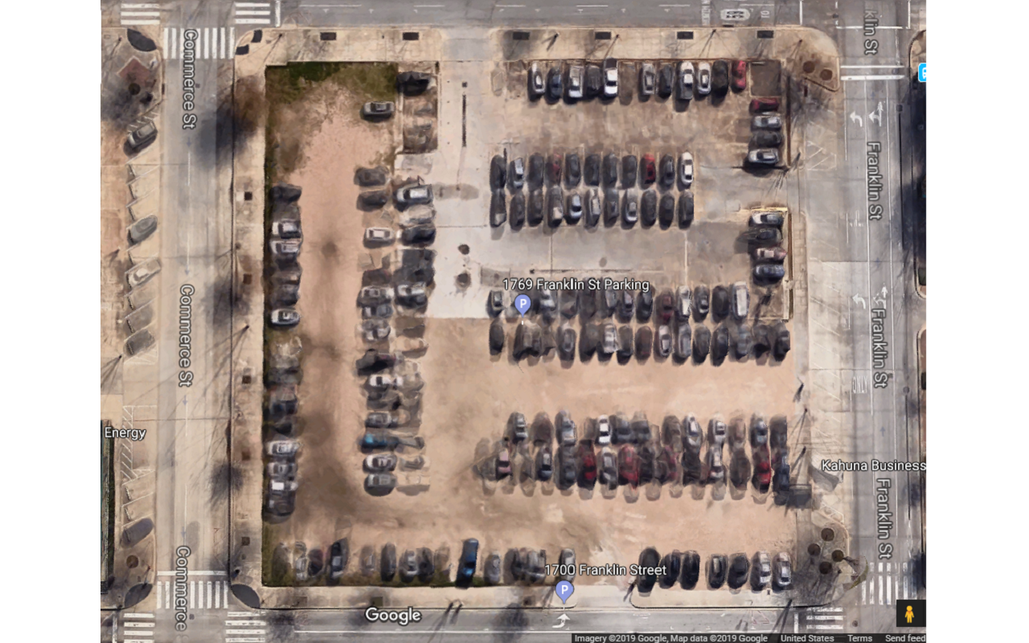
- Making the Map –

Slide 7

- Calculating Cost -
The algorithm can take advantage of cost of travel in the map
Custom-made Traffic heatmaps for simulation

Slide 8
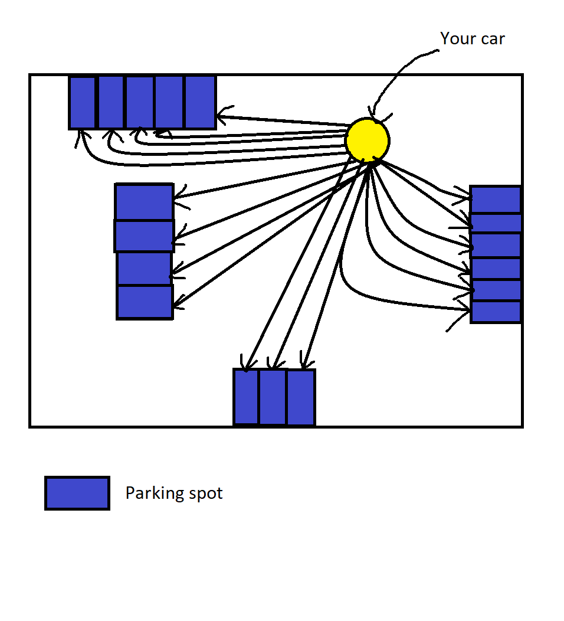
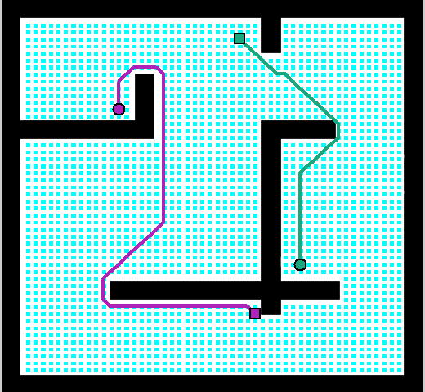
- Multi-Goal Pathfinding -

Slide 9
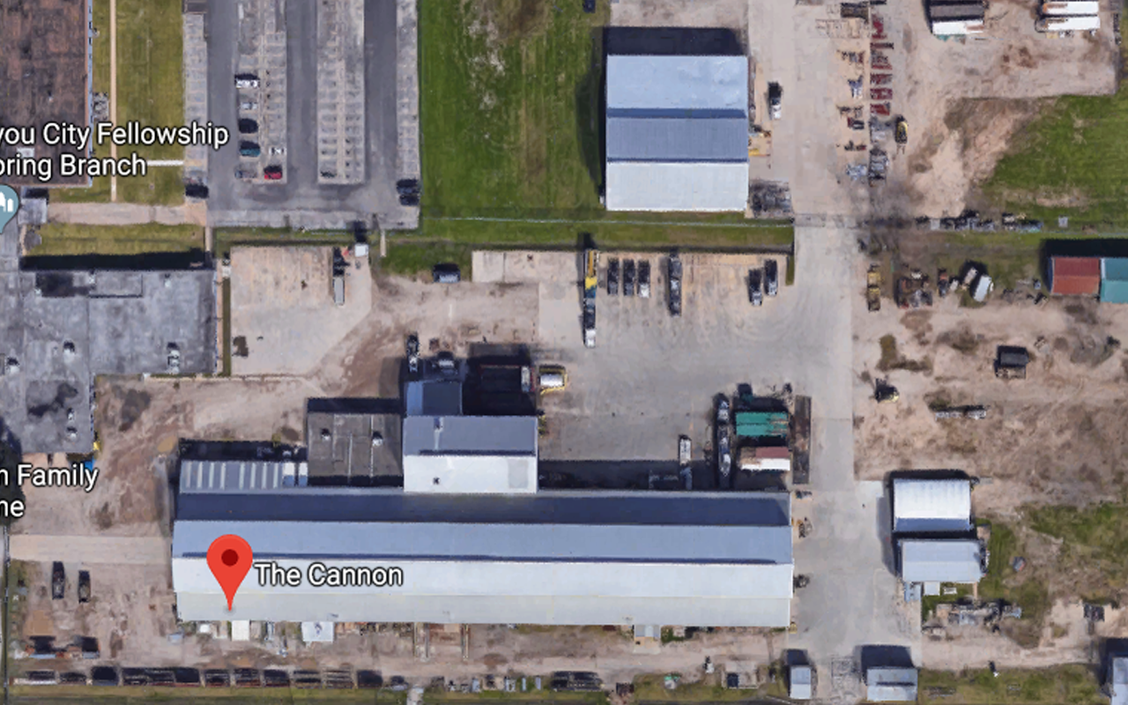
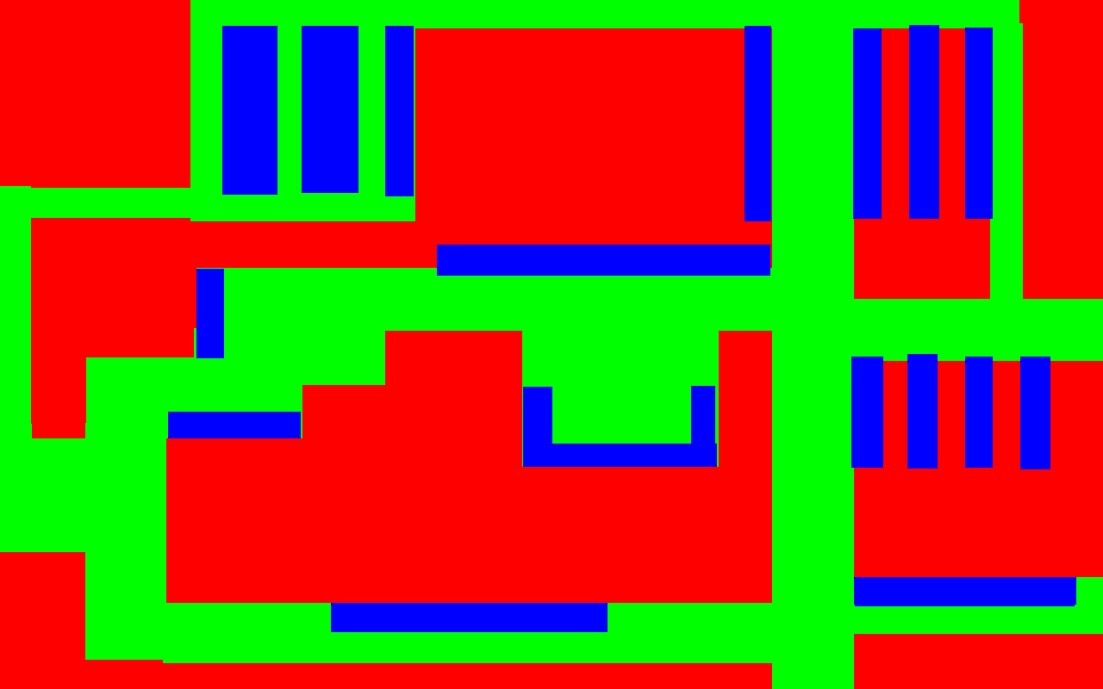

- Simulation -
For demo:
Cars simulated to park and leave
Linear interpolation performed between custom heat-maps representing traffic

Slide 10
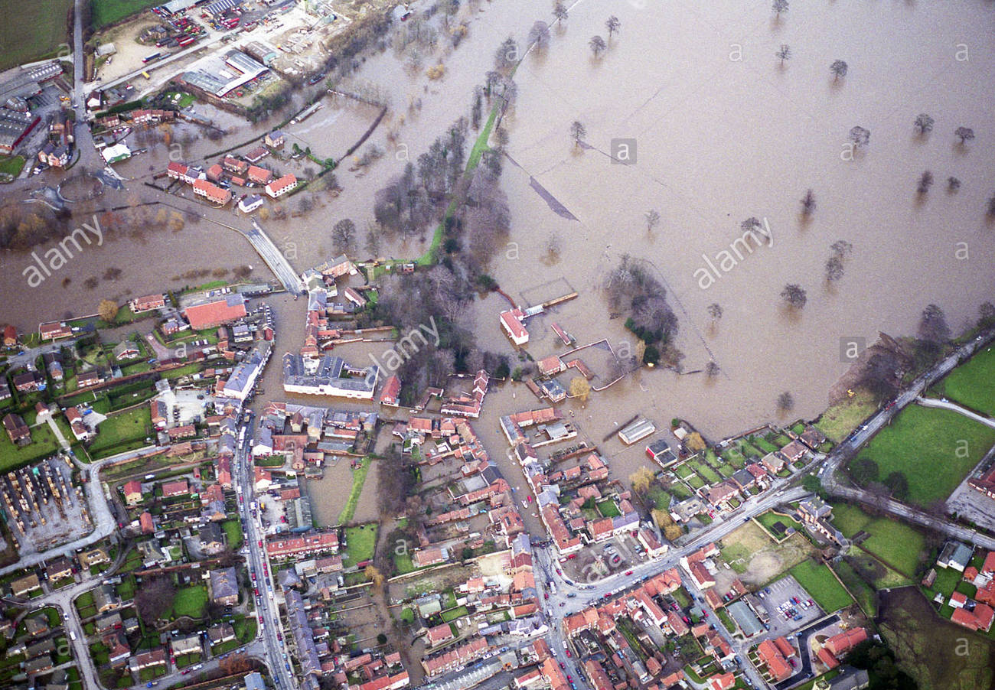
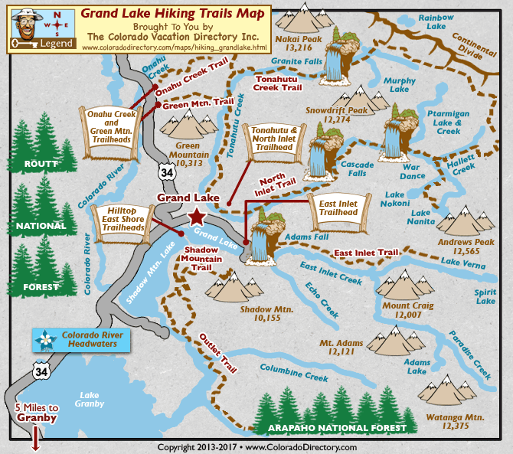
- Other Applications -
Not limited to parking:
Flood navigation
Trail navigation
Large-scale city navigation
Pokéstop Optimization!

Slide 11
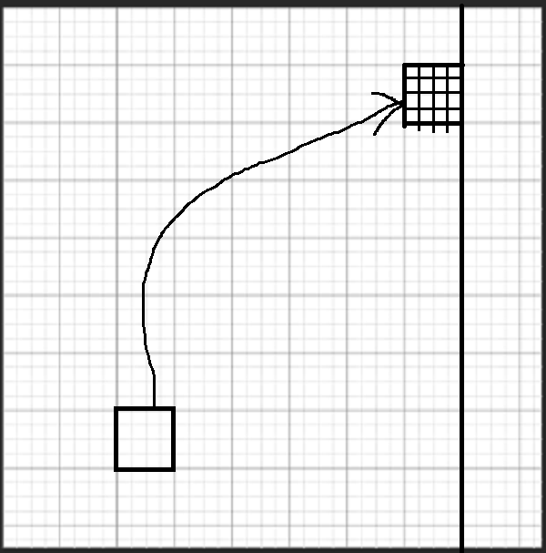
Problem with larger scale areas
(cities)
Limit: Complexity of Dijkstra’s algorithm is O(n^2), which might not be able to handle big-size city. (Note: n is the number of navigable cell in the grid)
Solution:
We can apply heap data structure into the Dijkstra’s algorithm. That will reduce the complexity to O(n*log2n)
Also, the cells can be downscaled and upscaled dynamically. For example with a grid 4x4:
If a cell represents (1 mile x 1 mile), the grid covers an area (4 miles x 4 miles)
If a cell represents (4 miles x 4 miles), the grid covers an area (16 miles x 16 miles)
Therefore, with the same complexity, we can cover a bigger area.

Slide 12
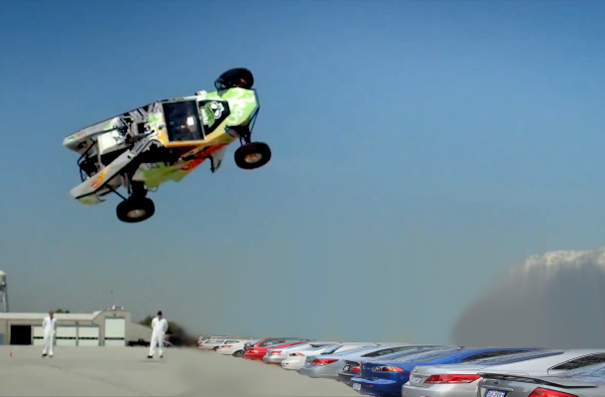
Parkour!
Visit our table for a live demo!

